Slide 1

TARGET FOLDER
SRNTGT104
War Cabinet Building, SRN
SECRET - DCS WORLD
REL TO COALITION
SECRET - DCS WORLD
REL TO COALITION

Slide 2


War cabinet Building, SRN
OPAC CLASSIFIED REL TO CJTF-23
JOINT OPERATIONS GRAPHIC 1/1
MAP
OVERVIEW
BE: SRNTGT104 CATCODE: 11
MIDB GEO: N 68 58.003 E 033 04.102
ICOD: 2011-JUL-06 DOI:2011-JUL-06
DECL ON: 2061-JUL-06
N
.
War Cabinet Building SRNTGT104

Slide 3
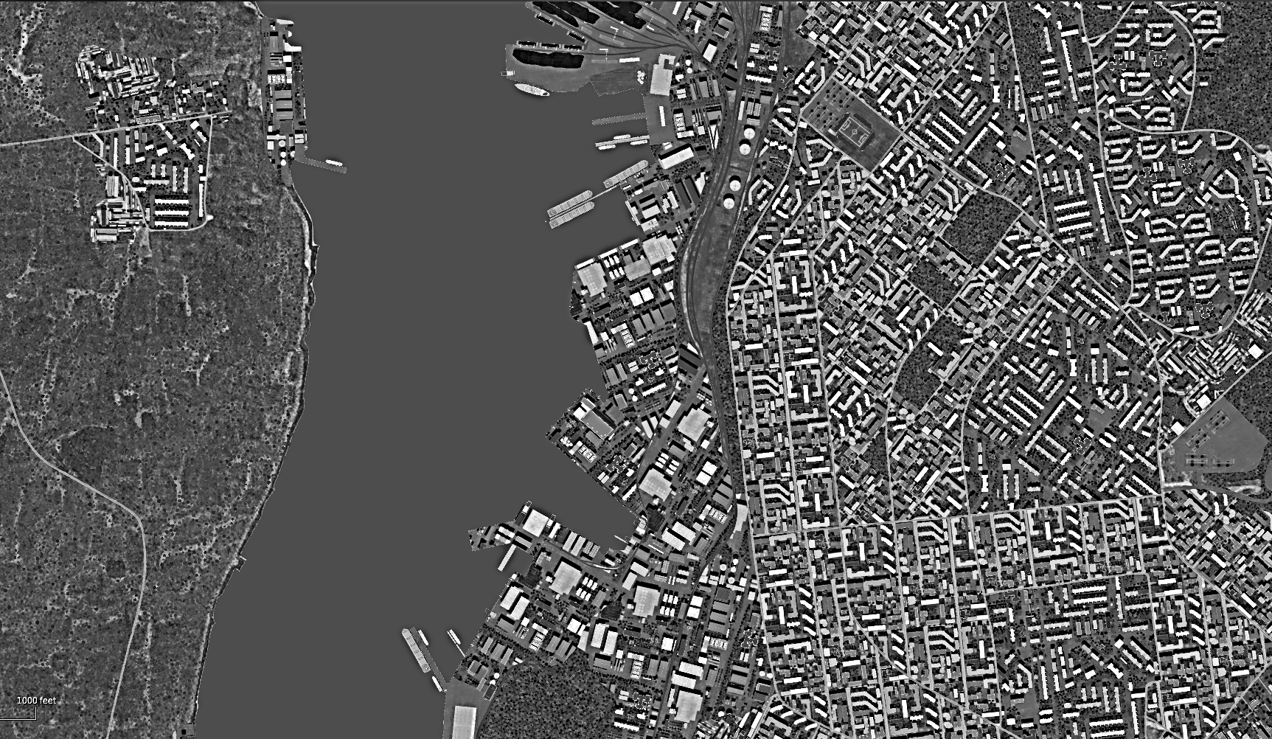
War cabinet Building, SRN
OPAC CLASSIFIED REL TO CJTF-23
FACILITY OUTLINE GRAPHIC 1/1
MAP
OVERVIEW
BE: SRNTGT104 CATCODE: 11
MIDB GEO: N 68 58.003 E 033 04.102
ICOD: 2011-JUL-06 DOI:2011-JUL-06
DECL ON: 2061-JUL-06
N
War Cabinet Building SRNTGT104

Slide 4
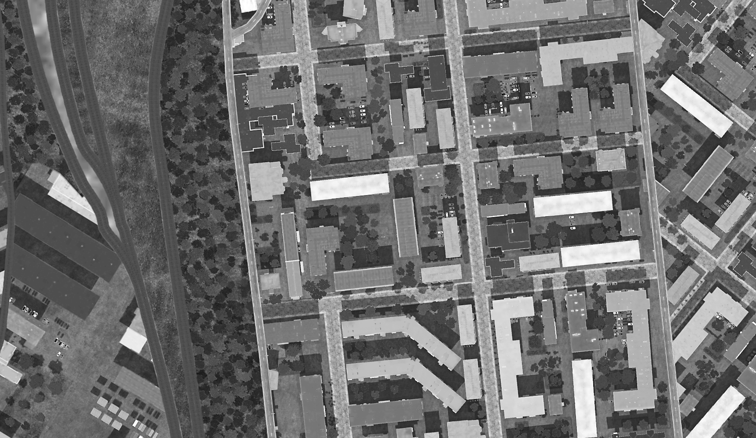
War cabinet Building, SRN
OPAC CLASSIFIED REL TO CJTF-23
DESIRED POINT OF IMPACT GRAPHIC 1/1
MAP
OVERVIEW
BE: SRNTGT104 CATCODE: 11
MIDB GEO: N 68 58.003 E 033 04.102
ICOD: 2011-JUL-06 DOI:2011-JUL-06
DECL ON: 2061-JUL-06
N
DPI: A
WAR CABINET BUILDING
N 68 58.003 E 033 04.102 DPI MSL: 94 FT

Slide 5
War cabinet Building, SRN
OPAC CLASSIFIED REL TO CJTF-23
WEAPONEERING OPTIONS 1/1
MAP
OVERVIEW
BE: SRNTGT104 CATCODE: 11
MIDB GEO: N 68 58.003 E 033 04.102
ICOD: 2011-JUL-06 DOI:2011-JUL-06
DECL ON: 2061-JUL-06
JDPI | DESCRIPTION | TLE | WARHEAD | GUIDANCE | DESIRED EFFECT | IMPACT ANGLE | FUZING
A | WAR CABINET BUILDING (HIGH COMMAND) | CAT 1 | 2x2000 lbs | METRIC | BLAST, FRAGMENTATION | 60-90 | 25ms

Slide 6
War cabinet Building, SRN
OPAC CLASSIFIED REL TO CJTF-23
COLLATERAL DAMAGE ESTIMATION GRAPHIC [X]
MAP
OVERVIEW
BE: SRNTGT104 CATCODE: 11
MIDB GEO: N 68 58.003 E 033 04.102
ICOD: 2011-JUL-06 DOI:2011-JUL-06
DECL ON: 2061-JUL-06
N
400ft
DPI A
NCC: UNKNOWN BUILDINGS
100FT W FROM DPI A
CDE 5

Slide 7
War cabinet Building, SRN
OPAC CLASSIFIED REL TO CJTF-23
COLLATERAL DAMAGES ESTIMATION 1/1
MAP
OVERVIEW
BE: SRNTGT104 CATCODE: 11
MIDB GEO: N 68 58.003 E 033 04.102
ICOD: 2011-JUL-06 DOI:2011-JUL-06
DECL ON: 2061-JUL-06
COLLATERAL DAMAGES WITHIN A 500M RADIUS
DESCRIPTION |  | CATCODE | MIDB GEOS | LOCATION | REMARKS
Civilian Structures |  | 14 |  | 100ft SW of DPI A | Significant Structural damage and Casualties.
NO STRIKE ENTITIES WITHIN A 500M RADIUS
NSE ID | DESCRIPTION | CATCODE | MIDB GEOS | LOCATION | REMARKS

Slide 8
War cabinet Building, SRN
OPAC CLASSIFIED REL TO CJTF-23
BATTLE DAMAGE ASSESSMENT GRAPHIC 1
MAP
OVERVIEW
BE: SRNTGT104 CATCODE: 11
MIDB GEO: N 68 58.003 E 033 04.102
ICOD: 2011-JUL-06 DOI:2011-JUL-06
DECL ON: 2061-JUL-06
POST-STRIKE
PRE-STRIKE
N
TARGET OBJECTIVE
DAMAGE/CHANGE ASSESSMENT
JDPI:[XXXXXX]
BDA REMARK: [CLASSIFICATION] [DISSEMINATION] Assessment: Physical Damage/change, Collateral Damage, Functional Damage/change, Munitions Effectiveness, Reattack Recommendation, Additional/Collateral Effects

Slide 9
ACRONYMS
ACRONYM | MEANING | DEFINITION
BE | Basic Encyclopedia Number | Alpha/numeric code unique to an installation for incorporation within various national and tactical systems.
CATCODE | Category Code | The data Element that classifies the function and purpose of an installation or a facility.
MIDB | Modernized Integrated Database | A database comprised of information on facilities of military significance, military forces, and related equipment.
ICOD | Intelligence Cut Off Date | The date of the latest intelligence data inputted to a feature.
DOI | Date of Image | Date on which a geospatial or intelligence-related image was captured.
CE | Critical Element | An element of an entity or object that enables it to perform its primary function.
JDPI | Joint Desired Point of Impact | A unique, alphanumeric coded aimpoint identified by a three dimensional mensurated point. It represents a weapon or capability desired point of impact or penetration.
CE90 | Circular Error at 90% | 90 percent confidence level in the horizontal plane.
LE90 | Linear Error at 90% | 90 percent confidence level in the vertical dimension
MSL | Mean Sea Level | Elevation above Earth reference geoid.
AGL | Above Ground Level | Elevation above ground surface.
NCC | Nearest Collateral Concern | Closest non-targeted structure, area, or entity near a planned point of impact that may be at risk of unintended damage during a military strike.
CER | Collateral effects radius | Radius within which collateral damage might happen based on the weapon's characteristics, the target environment, and other operational factors.
CDE | Collateral damage estimate | Systematic process used in military targeting to evaluate the potential for unintended damage or harm to non-combatant entities, structures, or personnel as a result of a planned strike.
NSE | No Strike Element | Specific entities, locations, or objects that are protected from intentional targeting under the Law of Armed Conflict (LOAC) or by operational policy.

Slide 10
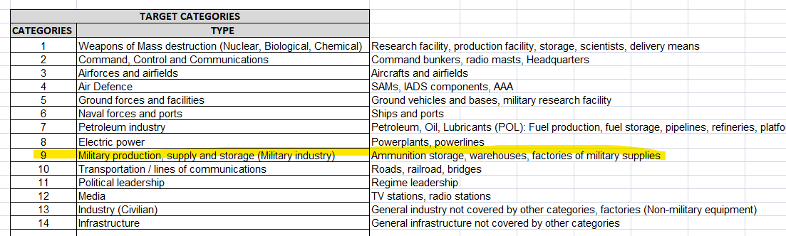

Slide 11

MILITARY KILL EFFECTS
Definition: destructive effects available upon detonation of a weapon.
KILL EFFECT |  | DEFINITION
BLAST |  | The high-pressure shockwave created by an explosion, traveling outward from the detonation point. Blast effects cause destruction by overpressure (compression force) and dynamic pressure (wind generated by the expanding gases), which can demolish structures, damage equipment, and injure personnel.
FRAGMENTATION |  | The dispersal of shrapnel or debris from an exploding munition. Fragments are propelled outward at high velocity, targeting personnel, equipment, and light structures in the area of effect.
PENETRATION |  | The effect of a munition or projectile piercing a target's surface without fully passing through it. Penetration is often used to defeat hardened targets, such as bunkers, by transferring energy into the target's structural layers.
INCENDIARY |  | The combustion of materials caused by incendiary munitions, secondary explosions, or the heat from a blast. Fire destroys flammable materials and can cause secondary damage to structures and equipment, as well as injuries to personnel.
CRATERING |  | The formation of a crater in the ground caused by the impact or detonation of a munition. Cratering disrupts mobility and operations, damaging roads, runways, or creating obstacles in the battlefield.
PERFORATION |  | The complete passage of a munition or projectile through a target, creating both an entry and exit point. Perforation may reduce the energy transfer to the target, making it less effective for destroying heavily armored or reinforced structures.
EARTH SHOCK |  | The seismic-like vibrations transmitted through the ground from an explosion. Earth shock can damage underground structures, destabilize foundations, or incapacitate personnel in subterranean environments.
NUCLEAR RADIATION |  | The release of ionizing radiation (alpha, beta, gamma, and neutron particles) from a nuclear explosion. Nuclear radiation can cause immediate biological damage, long-term health effects, and contamination of the environment.
THERMAL RADIATION |  | The intense heat and light energy emitted by an explosion, especially in nuclear detonations. Thermal radiation causes burns, ignites materials, and can create secondary fires in the target area.

Slide 12
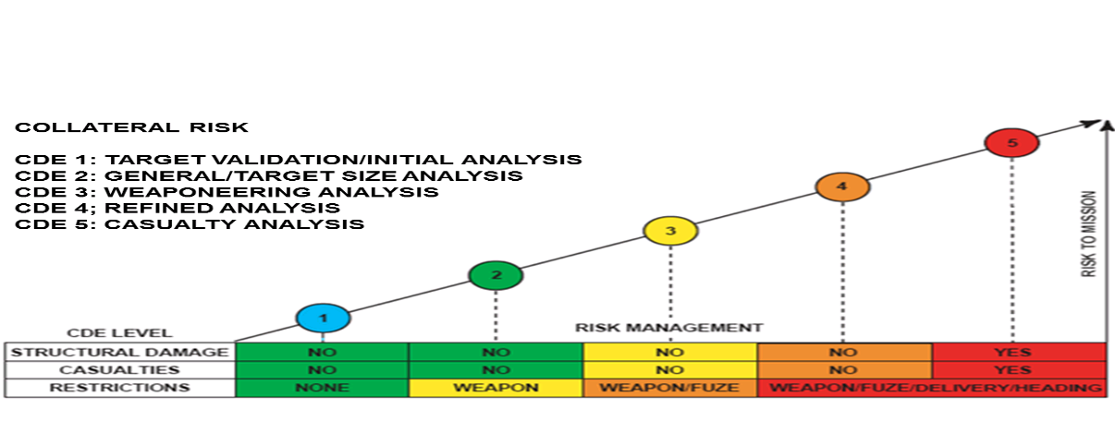
Collateral Damage Estimation Levels

Slide 13
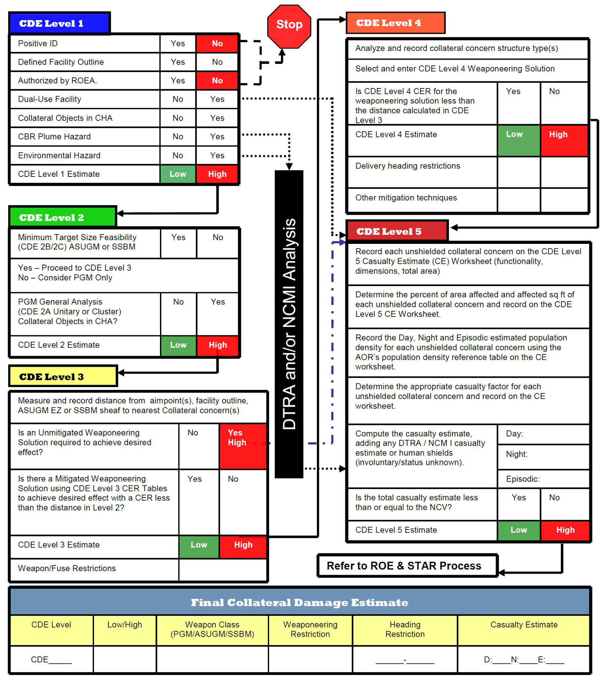
Collateral Damage Estimation Methodology

Slide 14
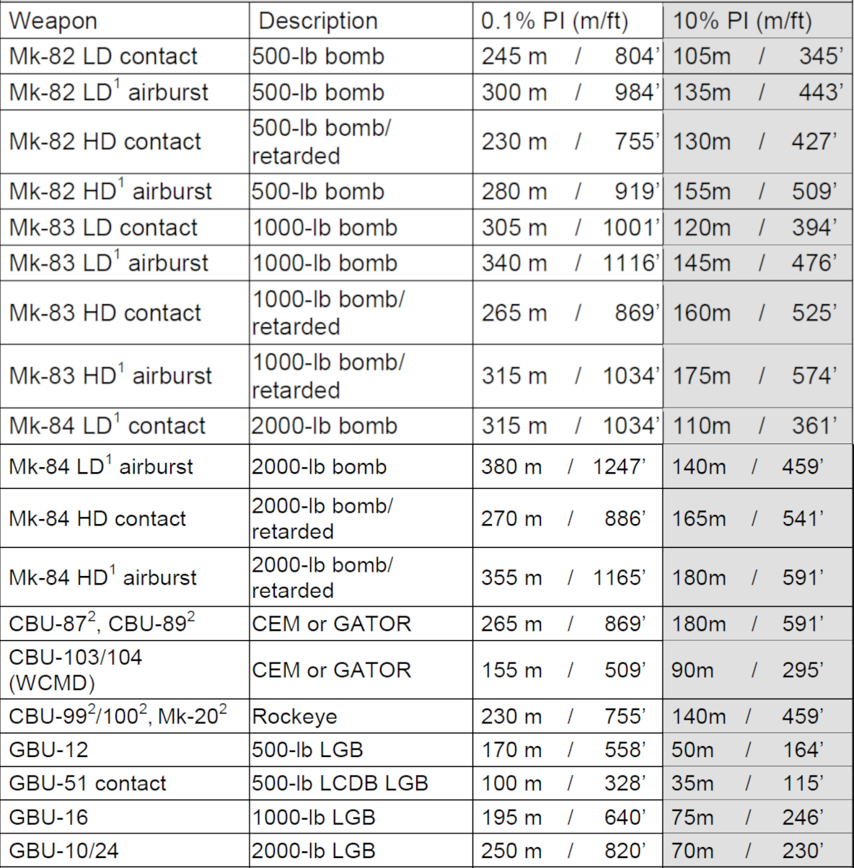
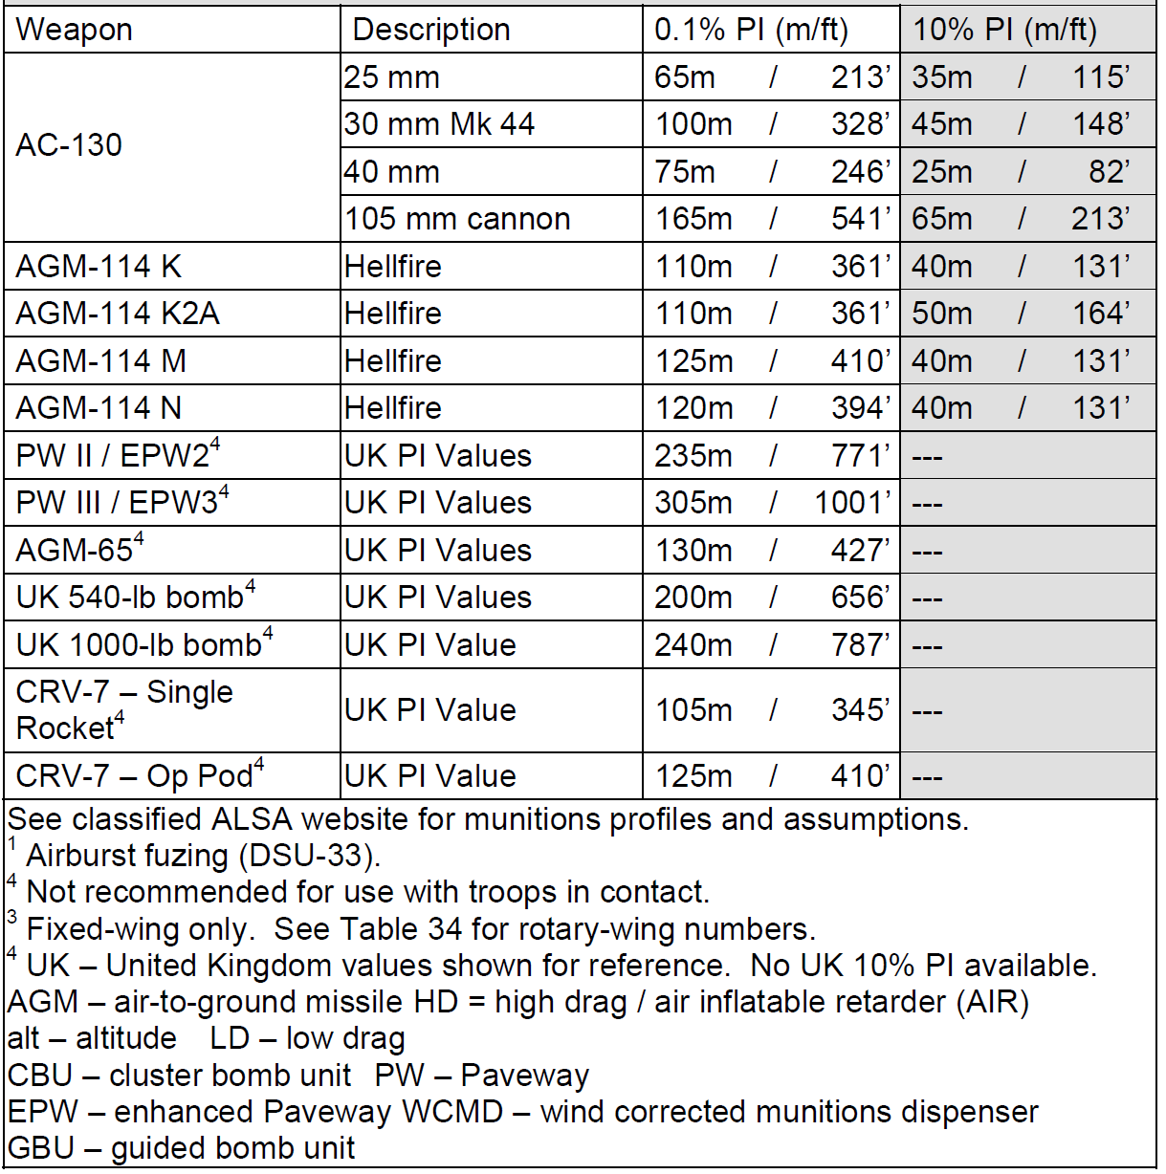
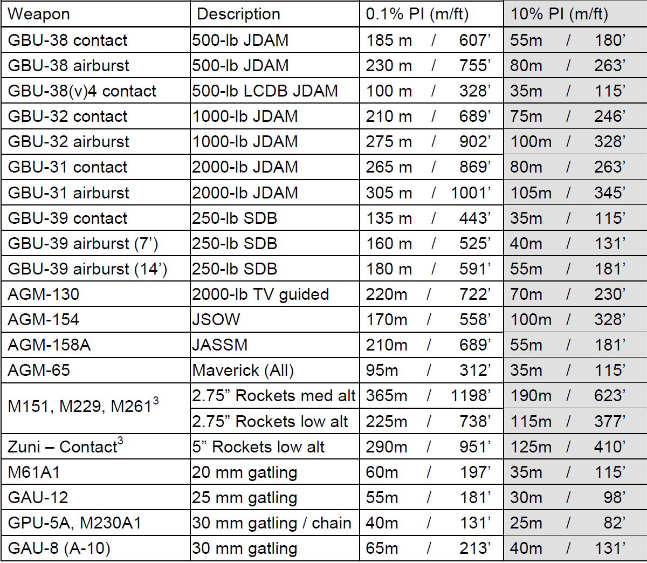
Risk Estimate Distance Table
(Fixed-Wing, 2007)

Slide 15
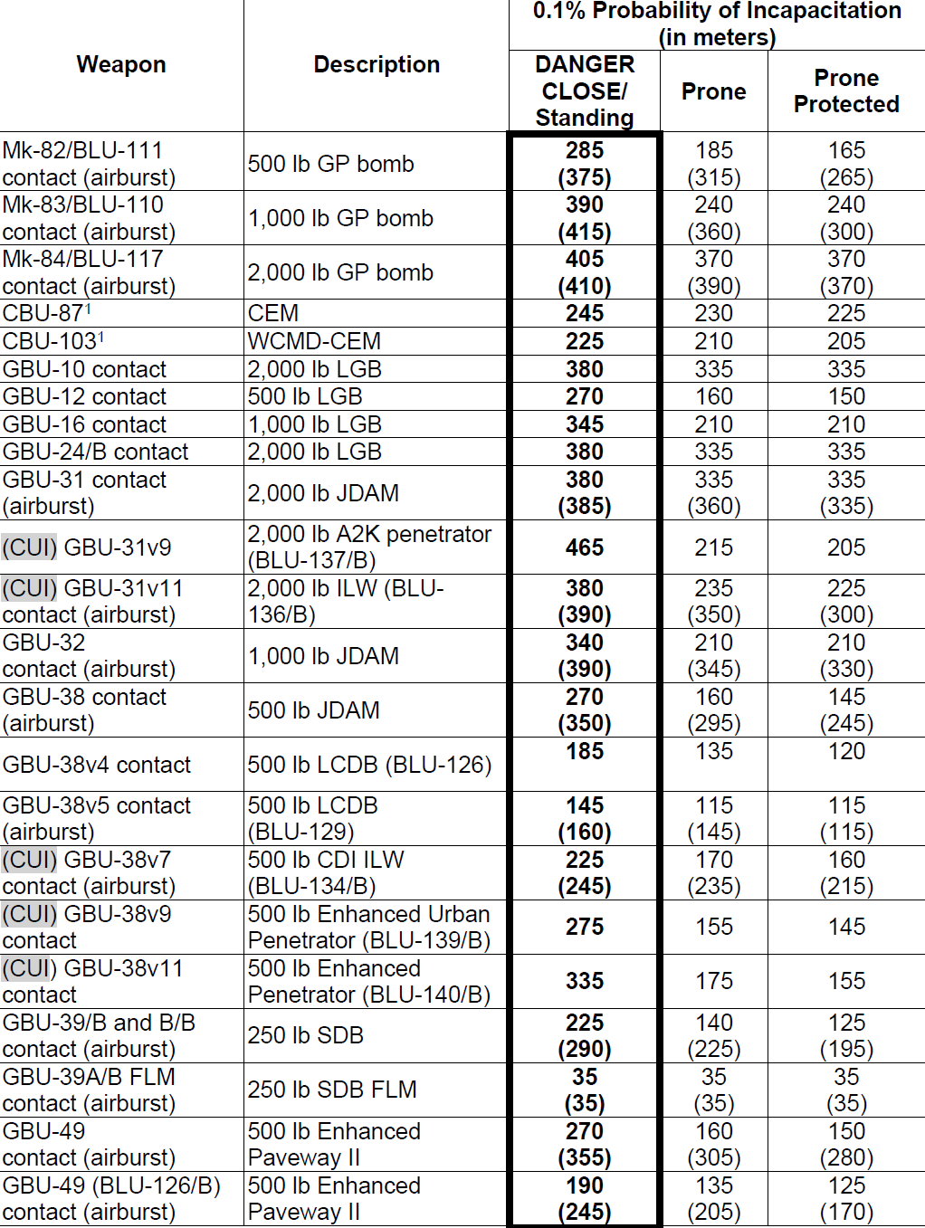
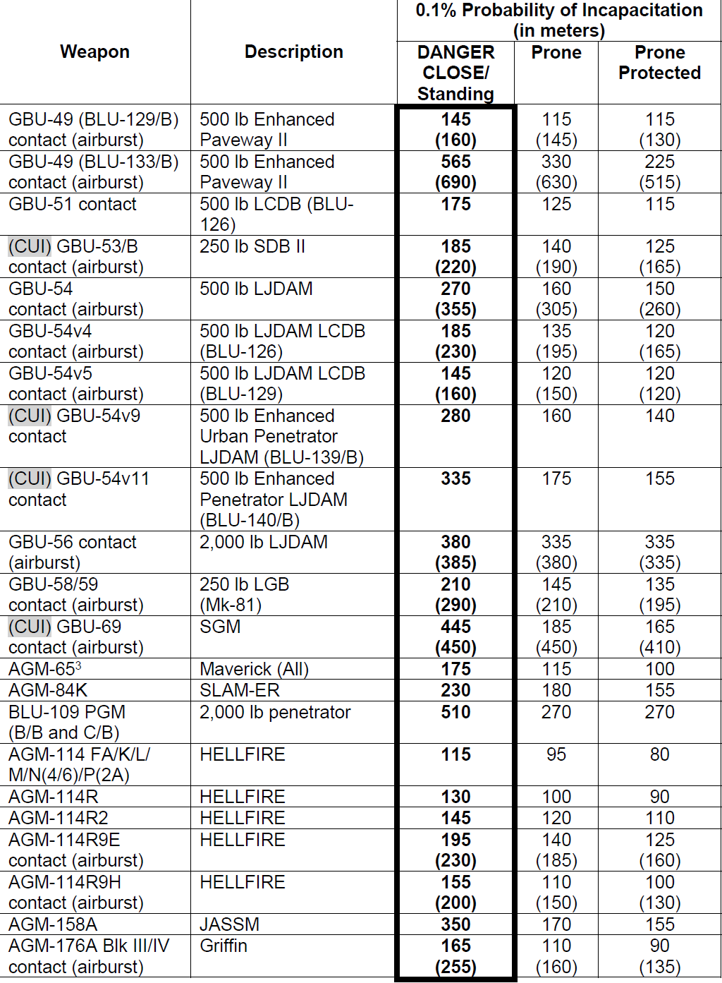
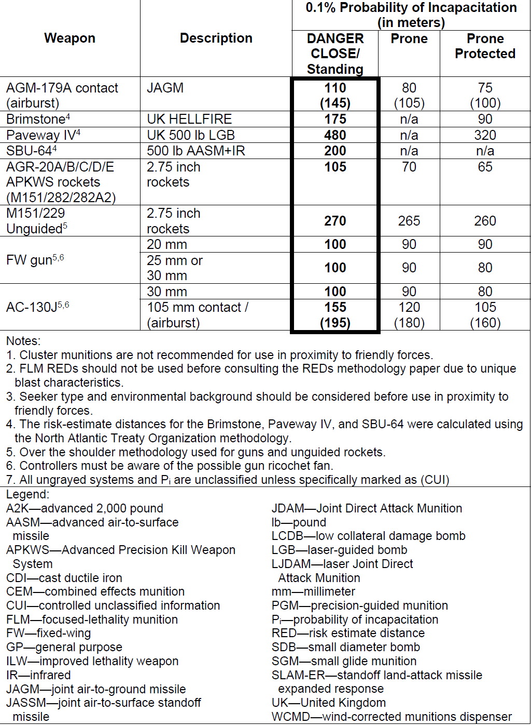
Risk Estimate Distance Table
(Fixed-Wing, 2023)

